Slide 1
Software Requirements specification (SRS) for Fraction Worksheet Creator
Prepared by Elementary Engineers:
Olga Sheehan, Sara Hakkoum,
Eric Holm, Ethan Fiero
Framingham State University
2016

Slide 2
Introduction
1.1 Purpose
give a detailed description of the requirements for the “Fraction Worksheet Creator” (FWC) software
explain system constraints, interface and interactions with other external applications
to be proposed to a customer for its approval and a reference for developing the first version of the system for the development team
1.2 Product Scope
FWC is an off-line worksheet generation tool to help elementary school teachers to create a lot of exercises for students to study and practice fractions.
Worksheets are randomly created, never repeated
Worksheets can contain fraction problems of various difficulty levels
Worksheets are free to print, easy to use, very flexible

Slide 3
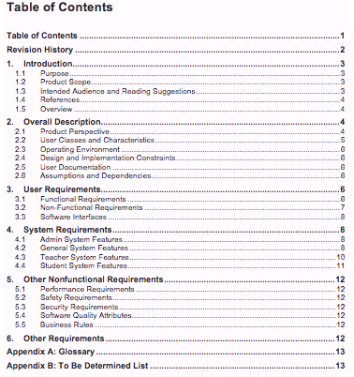
INTRODUCTION
1.3 Intender Audience
To be read by the customer, development team, the project managers, testers, documentation writers and end users.
1.4 References
1] IEEE Software Engineering Standards Committee, “IEEE Std 830-1998, IEEE Recommended Practice for Software Requirements Specifications”, October 20, 1998.
[2] –[5]
1.5 Overview

Slide 4
Description
2.1 Product Perspective
The Fraction Worksheet Creator (FWC) is a new stand-alone product that allows teachers and students to create random exercise worksheets to practice operations with fractions.
It is:
accessible offline
stores worksheets and user information
shared on a workstation

Slide 5
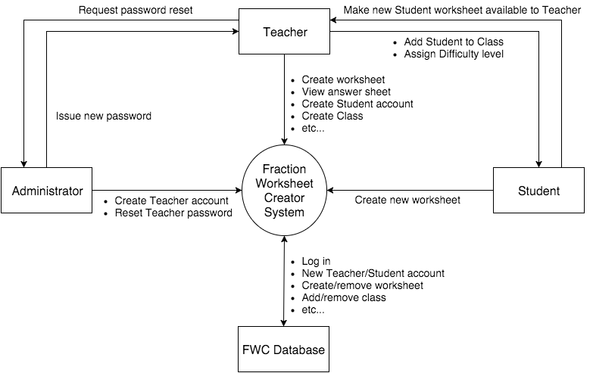
Description
2.1 Product Perspective
Figure 1 – Context diagram for release 1.0 of the Fraction Worksheet Creator

Slide 6
Description Continued
2.2 User Classes and Characteristics
Administrator
Teacher (favored)
Student
2.3 Operating Environment
any Operating System with Java installed
interface with Adobe Reader open worksheets
operate with any system that has a printer installed

Slide 7
Description Continued
2.4 Design and Implementation Constraints
Any version of Adobe Reader
Secure passwords of all user accounts
Maintenance of Teacher accounts will be responsibility of Admin
Re-install when Admin forgets master password
2.5 User Documentation
Help utility
Video tutorials
2.6 Assumptions and Dependencies
System also has Java and Adobe Reader installed
Teachers and Students allowed to save files to local system
Data only need to be accessed on the local system

Slide 8
User Requirements
3.1 Functional Requirements
Requirements for the Admin
General System Features
Teacher System Features
Student System Features
3.2 Non-Functional Requirements
OS systems it should run on
System should have access to a printer

Slide 9
User Requirements continued
3.3 Software Interfaces
will interface with a database
interface with an API for the creation of PDFs
interface with Adobe Reader

Slide 10
System Requirements
4.1 Admin System Features
4.1.1 Teacher Registration
- Register Teacher Accounts
4.1.2 Teacher Password Reset
- Admin shall reset teachers’ account passwords
- Generates a randomly generated password

Slide 11
System requirements continued
4.2 General System Features
4.2.1 Admin Account Setup
4.2.2 Graphical User Interface
4.2.3 Help System
4.2.4 Worksheet Difficult
4.2.5 Worksheet Types
4.2.6 Tutorial Content
4.2.7 Random Exercise Generation
4.2.8 Worksheet Instructions
4.2.9 Worksheet Output
4.2.10 Search Feature

Slide 12
System Requirements Continued
4.3 Teacher System Features
4.3.1 Teacher System Access
4.3.2 Teacher Password Reset
4.3.3 Teacher Worksheet Selection
4.3.4 Worksheet Parameter Options
4.3.5 Student Worksheet Review
4.3.6 Student Worksheet Deletion
4.3.7 Class Roster Creation
4.3.8 Student Login Management
4.3.9 Student Difficulty Level Management

Slide 13
System requirements continued
4.4 Student System Features
4.4.1 Student System Access
4.4.2 Student Password Reset
4.4.3 Student Worksheet Option

Slide 14
Other nonfunctional Requirements
5.1 Performance Requirements
Number of Users shall not be limited
5.2 Safety Requirements
None have been identified
5.3 Security Requirements
Only allow authorized users
Require username and password
Securely Store password in a database
5.4 Software Quality Attributes
Correctness
Interoperability
Usability

Slide 15
Other Nonfunctional Requirements continued
5.5 Business Rules
Do not allow students to register
Allow teachers to register student accounts
Allow the administrator to register teacher accounts
Allow students to generate worksheets
Allow teachers to view answer sheets
Access previously created worksheets

Slide 16
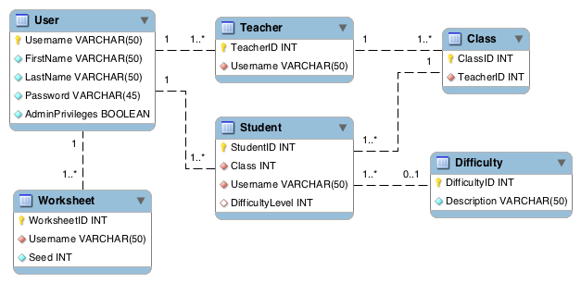
Other Requirements
6.1 Database Schema

Slide 17
User Interface Mock-Up

Slide 18
Questions?

